Slide 1
Welcome to DevTube
An AI-powered, distraction-free technical learning ecosystem designed to convert unstructured web chaos into focused developer growth.

Slide 2


The Problem: Why YouTube is Distracting
The Dopamine Trap & Noise
Absence of Structured Roadmaps
Traditional video platforms blend high-entertainment feeds, algorithmic shorts, and viral notifications directly alongside serious technical tutorials, shattering developer concentration.
Learners face choice overload and rabbit holes without clear prerequisites, milestone checks, or curated pathways to master Full-Stack Engineering, NLP, or ML.

Slide 3

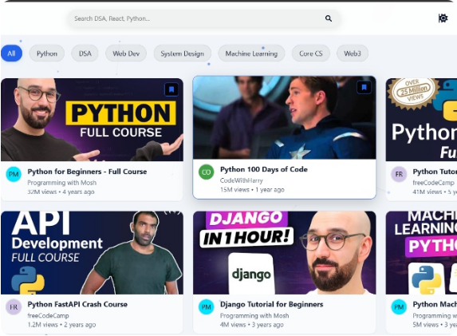
Why I Built DevTube & Platform UI
•
Zero-Distraction Environment: Engineered a minimalist dashboard tailored strictly for focused developer tutorials.
•
Data-Driven Discovery: Integrated robust educational datasets directly into an interactive learner dashboard.
•
Active Career Growth: Shifted the paradigm from passive video watching to milestone-driven skill execution.

Slide 4

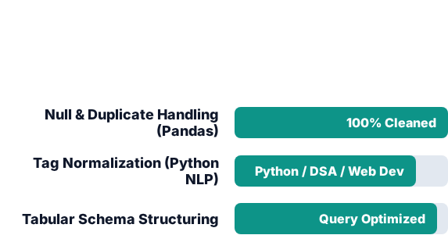
Data Analysis & Preprocessing Pipeline
Using Kaggle's Udemy online education dataset, raw records were cleaned, normalized via Python Pandas, and indexed to power accurate recommendation cards.
[ Pandas Dataframe Pipeline ] df.dropna() df['tags'].str.lower() SQL / MongoDB Indexing

Slide 5
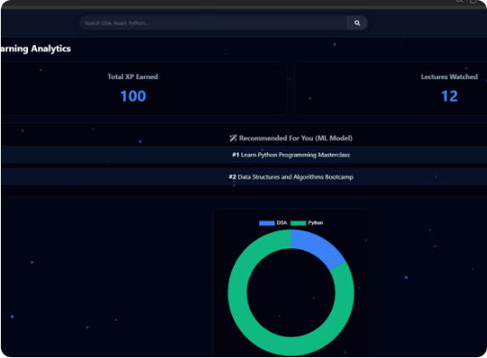
System Architecture & AI/ML Tech Stack
•
Frontend UI: HTML5, CSS3, and Vanilla JavaScript responsive interface.
•
Backend API: Node.js with Express.js RESTful routes handling server requests.
•
ML Model & Training: Python, Pandas, & NumPy for data manipulation, tag clustering, and dataset optimization.
•
Generative AI & APIs: Integrated Google Gemini API and custom AI assistants for dynamic career roadmap generation and intelligent topic summaries.
•
Database Layer: Local XAMPP MySQL and MongoDB integration for persistent user XP and stats.

Slide 6
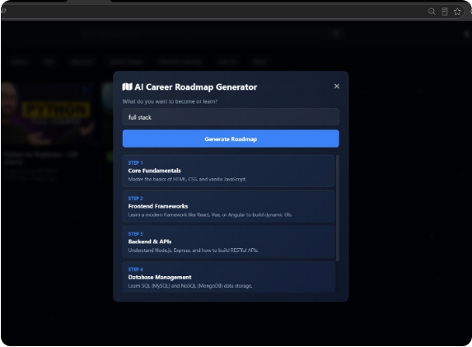
AI Career Roadmap Generator
The built-in AI roadmap generator prompts learners for their target career or domain, instantly assembling a structured, step-by-step learning progression path from core fundamentals to advanced mastery.
•
Step 1: Core Fundamentals (HTML, CSS, JS)
•
Step 2: Frontend Frameworks (React, Vue)
•
Step 3: Backend & APIs (Node.js, Express)
•
Step 4: Database Management (SQL & NoSQL)

Slide 7


Future Scope & Scaling Roadmap
Platform Enhancements
Community & Ecosystem
•
Real-Time API Integration: Connect directly with the YouTube Data API v3 to fetch live tutorial feeds without ads.
•
Peer Code Reviews: Introduce a built-in community code editor and review system for learners.
•
•
Enterprise Analytics: Provide structured progress reports and skill verification badges for bootcamps and colleges.
Advanced ML Recommendation: Upgrade from basic keyword filtering to collaborative filtering using cosine similarity.

Slide 8



Project Resources & Links
Live Application
GitHub Source
Kaggle Dataset
devtube-sable.vercel.app
github.com/sakshishikha8-cloud/devtube
udemy-online-education-courses

Slide 9
Thank You!
Questions & Discussion
Built with Passion by Sakshi Shikha

